Slide 1
Skytrax Airways
Review Analysis

Slide 2
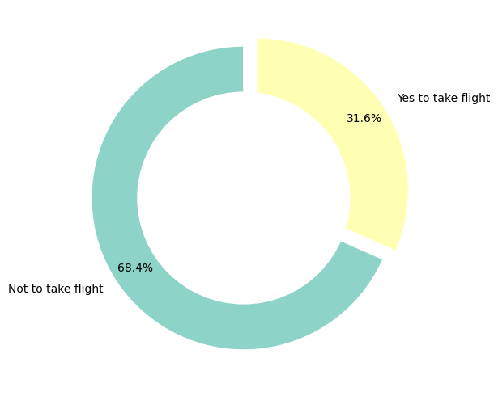
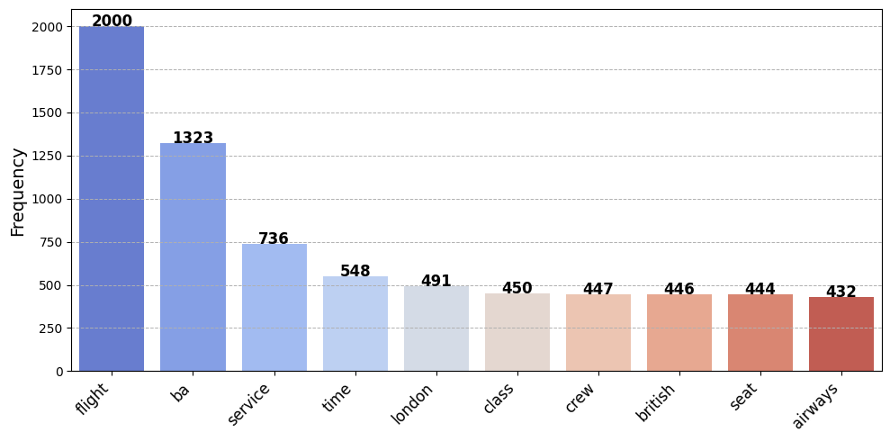
Result:
Key Topics: Sentiment:
The chart shows that the key topics within the reviews include Out of 1000 reviews, 68% recommendations are negative and “flight”, “service”, “time”, “class”, “seat”, 31% are positive.
showing that people are actively taking about their experience

